Slide 1
NodeMCU Programming
Session: 2

Slide 2
Topics covered in this session:
Prerequisites
Resources
Arduino IDE Installation
Introduction to NodeMCU hardware and Arduino IDE - Program Structure and how LEDs work?
Blink Code.
DIY using Simulation!!!

Slide 3
1.1 Prerequisites
Basic Programming knowledge. (C, C++, etc)
Understanding of Electronics. (Basic Electronics)
2 Resources Needed:
Integrated Development Environment installed. (Arduino IDE)
1 NodeMCU ESP8266 WiFi microcontroller
1 Breadboard, 1 LED & Resistor for LED, Few jumper wires
1 Micro-USB cable
A Laptop

Slide 4
Arduino IDE Installation
1. Install the Arduino IDE from https://www.arduino.cc/en/Main/Software Install the IDE and the drivers that come with it.
MAC: Install also these drivers https://www.silabs.com/products/development-tools/software/usb-to-uart-bridge-vcp-drivers
2. Open Arduino IDE and add the board manager link to the preferences.
Open “Preferences” menu in File -> Preferences Check the boxes in the preferences according to the picture in the next slide for a better development interface.
Also, add the link http://arduino.esp8266.com/stable/package_esp8266com_index.json to “Additional Boards Manager URLs” and save settings by pressing OK.

Slide 5
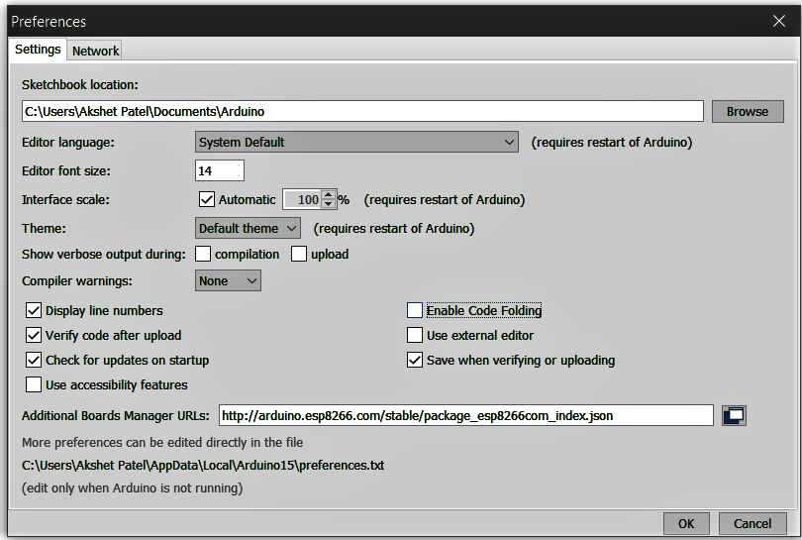

Slide 6
3. Install the new board manager for ESP8266 chip
In the Arduino IDE Go to Tools -> Board (…) -> Boards manager…
Search for “ESP8266”, click the suggested result and press install. 4. Confirm the installation and choose the NodeMCU board for the current board
Go to Tools -> Board (…) and select “NodeMCU 1.0 (ESP 12-E module)” from the list.
DONE WITH THE CONFIGURATION!

Slide 7
Programming the NodeMCU Using Arduino IDE:
Arduino IDE - Text editing program
Sketch (Code File) > High Level Language > Compile > Machine Language
IDE - Translates and Compiles the code - Understand by NodeMCU
Mistakes/ Errors?
The serial monitor - interacting - using the computer - real-time monitoring and analysing.

Slide 8
Introduction to hardware and Arduino IDE - Program Structure & How LEDs work?
Each arduino program has two mandatory functions: setup() and loop().
The code inside the setup() function is executed once .
The loop() function is run constantly while the microcontroller is powered.

Slide 9
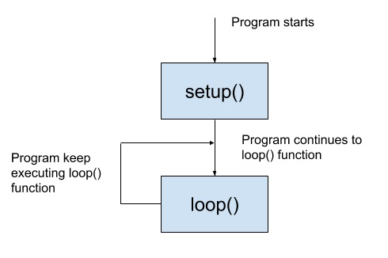
Basic operation of an arduino program:
A function is a group of statements that together perform a task.

Slide 10
Commands in setup() function:
Declaring pins: Variables const int LED = 4; // NOTE! You can use either 4 or D2 value for the same pin.
Defining the type of the pin, or the pin mode: pinMode(pin, mode); // e.g. pinMode(LED, OUTPUT);
Modes: INPUT // e.g. buttons, switches, keyboards, etc. OUTPUT // e.g. LEDs, screens, etc.

Slide 11
Commands in loop() function:
Digital pins:
digitalWrite(pin, value); // values are used to activate the pin. digitalRead(pin);
Values:
value - LOW // Off
value - HIGH // On

Slide 12
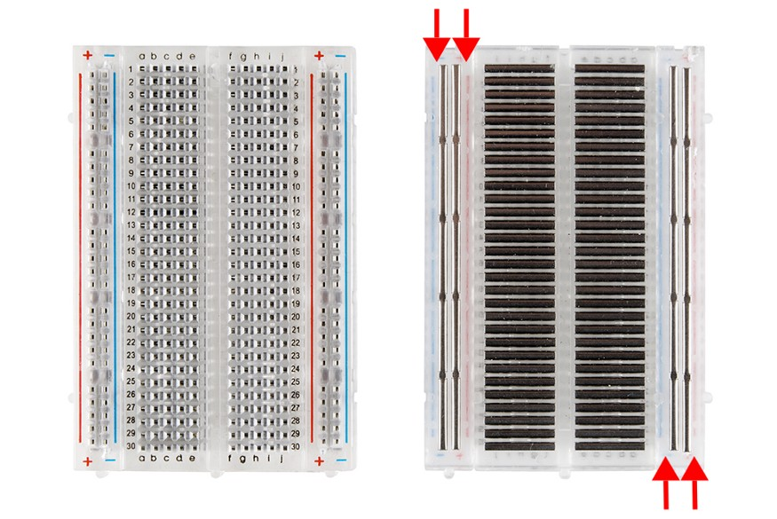
Breadboard:

Slide 13
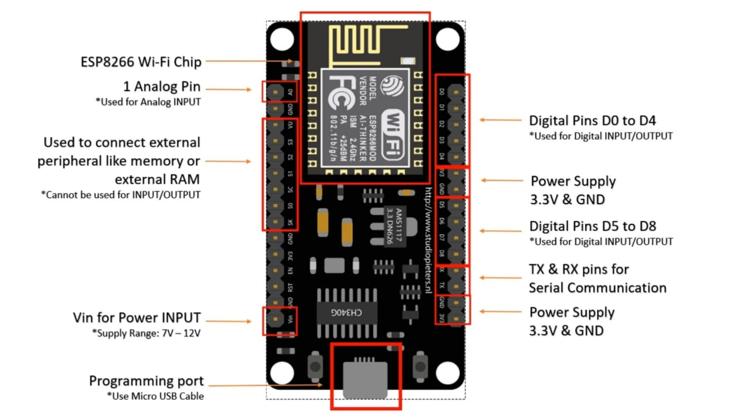
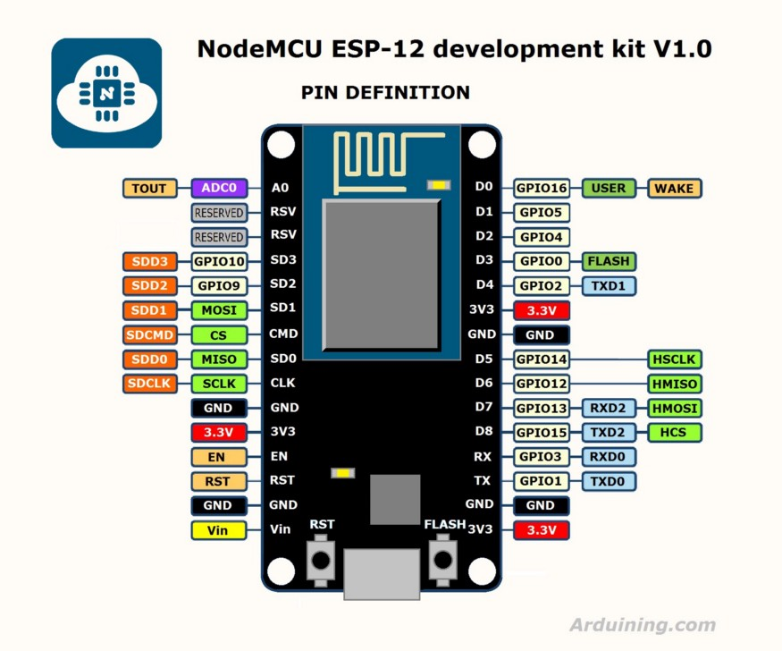
NodeMCU Hardware:

Slide 14
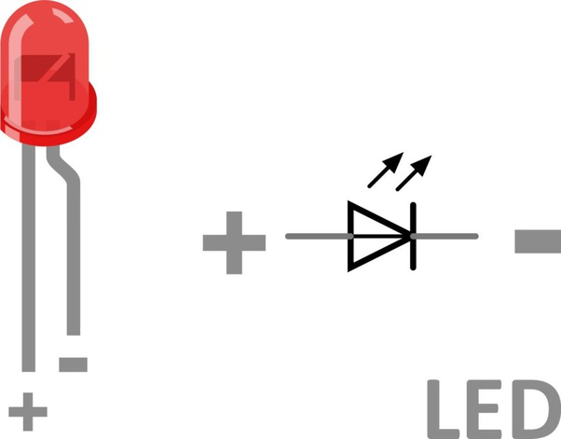
LED:

Slide 15
TinkerCAD
Free online collection of software tools.
Design basic circuits and also simulate them including Arduino.
Easy-to-use app for 3D design, electronics, and coding.
www.tinkercad.com

